Slide 1
ICT Web Design
Lesson 3 – Principles of Web Design
V2.0

Slide 2
Basics of HTML

Slide 3
Objectives
3.3.1: Define "HTML (Hypertext Markup Language)" and related terms, including tag vs. element, container vs. empty tag, block-level vs. inline element, attribute, value, and semantic tag.
3.3.2: Identify HTML elements required to create Web page structure.
3.3.3: Create Web pages using basic HTML tags (e.g., headings, lists, character styles, text alignment, tables, comments).

Slide 4
Background Internet & WWW
How the web works

Slide 5
Internet
Large network of servers
that store information
and provide multiple services
using different protocols
and can be accessed by various clients.
Services like:
WWW
e-mail
FTP

Slide 6
World Wide Web
A system of
tools (for example, Web browsers) and services
allow us to access the information
on a portion of the Internet.

Slide 7
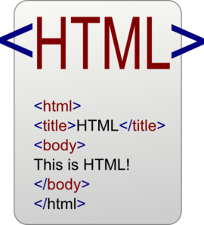
History HTML
Hyper Text Markup Language
Authoring language used to create documents on the World Wide Web.
Defines the structure and layout of a Web page (How a page looks and any special functions).
HTML uses “tags”

Slide 8
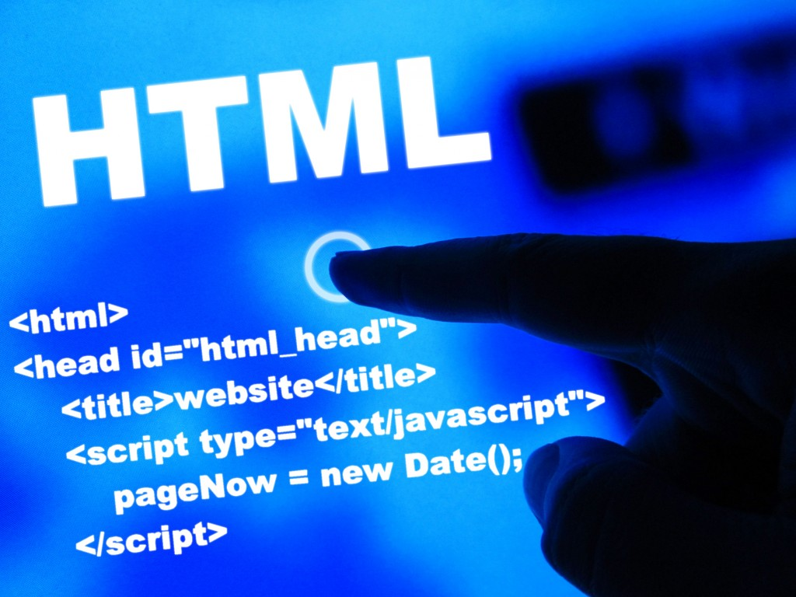
Hypertext / Hyperlinks
Hypertext: text that links to other information.
Hyperlink: reference (link) to information in a different location

Slide 9
History HTML
Inventor: Tim Berners-Lee & colleagues
CERN: European particle physics laboratory
Early1990’s
HTML (hypertext markup language)
HTTP (HyperText Transfer Protocol) protocol used to transfer web site data over the Internet Web sites begin with http://
URLs (Universal Resource Locators)

Slide 10
Web Page – Web Site
Web page is an individual HTML document
written in HTML (hypertext markup language)
translated a web browser.
Web site is a collection of web pages.

Slide 11
Web Server – Web Browser
Web server: a computer system that hosts websites
Connected to the Internet – high speed connections – at a web host
Web browser: an application (software) used to access and view websites
Client based (on your local computer)
Examples: Microsoft Internet Explorer, Google Chrome, Mozilla Firefox, and Apple Safari

Slide 12
World Wide Consortium W3C
International community
Develop standards, protocols, and guidelines
Help to ensure that:
Web browsers display Web pages consistently
across platforms
Provide:
standards for applications, scripts and dynamic content
privacy and security guidelines

Slide 13
Introduction to HTML
HTML is the language used to create Web pages.
Tags create structure (such as paragraphs and lists).
Tags tell the browser how to display the text contained in the document.
HTML tags must be surrounded by angle brackets ( < > ).

Slide 14
Tags: Elements
Element: the text inside the angle brackets <title>
Used to create structure (format)
Tell the browser how to display the content

Slide 15
Container Tags
Container tag: includes a set of opening and closing tags.
<title> This is my page title </title>
The closing container tag contains a forward slash (/) that tells the browser the tag has ended.

Slide 16
Empty Tags
Empty tag: does not contain content
Does not need a closing tag.
Example: <br/> add a single line of space,
You can use one or more break tags to create lines of empty space

Slide 17
Case Sensitivity
NOT case sensitive
lowercase <p>...</p>
uppercase <P>...</P>
Can’t mix and match: <P> and </p>
Considered best practice to write all opening and closing tags in lowercase.
<title> This is my page title </title>

Slide 18
DOCTYPE
First line of an HTML document: <!DOCTYPE> declaration
<!DOCTYPE> declaration is not an HTML tag.
Instruction to the web browser about what version of HTML the page is written in.
It defines the document type.

Slide 19
Open / Close HTML
All HTML documents must start and end: <html> and </html>.
Tells the browser the document is written using the HTML language and needs to be rendered (or displayed) using the HTML rules.
All other tags in the document are nested within the <html>tags.

Slide 20
Basic Page Structure
HTML documents are made up of two sections:
<head> </head>
<body> </body>
<!DOCTYPE html>
<html>
<head>
</head>
<body>
</body>
</html>

Slide 21
Head Tag
<head> information needed by the browser and search engines
document title,
page description,
a link to a file that helps display the page properly,
or a file that creates the document's interactivity.
<head>
<title>This is my web page title</title>
<meta name=“description” content=“This is a description of my web page”>
<link rel=“stylesheet” type=“txt.css” ref=“style.css”>
</head>

Slide 22
Meta Data
Metadata describes other data. It provides information about a certain item's content.
Metadata is inserted in the <head> section of the HTML document

Slide 23
Meta Data: description
Use a unique meta description on each page to make it relate to that page’s content.
The meta description is often what Google displays in its search result description.
<meta name="description" content="Savvy Book Finder specializes in finding rare books, literary classics, historic and antique books. If we don’t have what you are looking for, we will find it!”>

Slide 24
Meta Data: keywords
Meta keywords are a way to communicate with the search engines that index pages for online Web indexes.
<meta http-equiv="keywords" content="used Books, fiction, textbooks, non-fiction, literary classics, historic books, antique books">

Slide 25
Body
Body tags: contain all other HTML document content, such as text, images and videos.
The content within the body tags is displayed in the browser window.
<body>
<p>The content within the opening and closing body tags will be displayed in the browser window.</p>
</body>

Slide 26
Save as - .html
Save as either .htm or .html
Example: myFirstPage.html.
.html file type tells the computer that the file is an HTML document and should be opened in a browser.

Slide 27
Saving – Home page
index.html
Home or base page
Default page for web server

Slide 28
Elements of a Web Page

Slide 29
Block Level
Block-level Element = occupies the entire space of its parent element (container), thereby creating a "block”.
<p>This paragraph is a block-level element; its background has been colored to display the paragraph's parent element.</p>

Slide 30
Block Level
Often called “paragraph-level”
Only appear between <body> </body> tags.
Browsers usually add blank space, called a "new line", before a block-level element .
Borders: default = 0
Examples: <p>, <div>, <form>, <header>, <nav>, <ul>, <li>, and <h1>

Slide 31
Inline
Inline Element = contain only data and other inline elements.
<p>This <span>span</span> is an inline element; its background has been colored to display both the beginning and end of the inline element’s influence </p>

Slide 32
Inline
Often called “text level”
Do not add the blank line of space
No “borders”
Examples: <a>, <span>, <b>, <em>, <i>, <cite>, <mark>, and <code>

Slide 33
Paragraph Tag <p>
Often called most important tag
Creates a new paragraph
Block-level
Creates a space between lines

Slide 34
Paragraph Tag <p>
<p> tag defines a paragraph.
Browsers automatically add some space (margin) before and after each <p> element.
<p>This is some text in a paragraph.</p>

Slide 35
Heading Tags
Define hierarchy and structure of a Web page.
6 levels
<h1> element is the highest level and uses the largest font size.
<h6> element is the lowest level and uses the smallest font size
Container tags
Heading tags automatically make the text contained within it bold.
Headings automatically add a line between the heading content and any text before or after it.

Slide 36
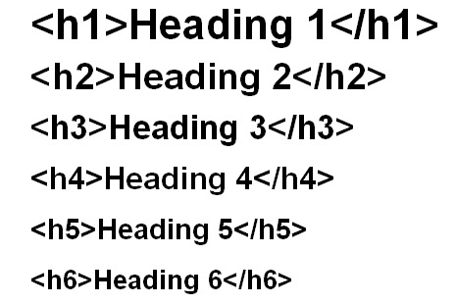
Heading Tags

Slide 37
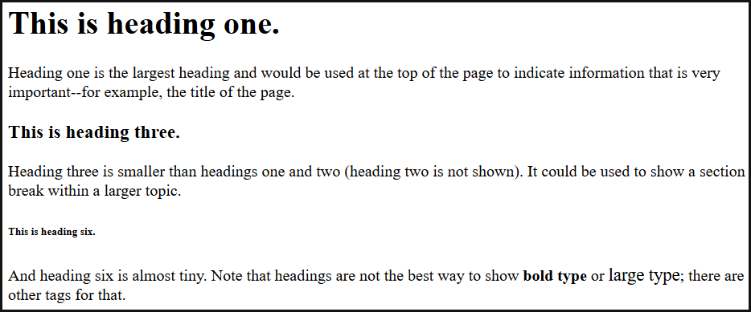
Heading Tags

Slide 38
List Tags - Ordered
Ordered list: display information
Letters
Numbers
Other values
An ordered list starts with the <ol> tag.
Each list item starts with the <li> tag. The list items will be marked with numbers.
Ordered List Type | Example
<ol type=1”> </ol> | 1,2,3,4
<ol type=“A”> </ol> | A,B,C,D
<ol type=“a”> </ol> | a,b,c,d
<ol type=“I”> </ol> | I,II,III,IV
<ol type=“i”> </ol> | i,ii,iiii,iv

Slide 39
Ordered List
<ol type="I">
<li>Cocoa</li>
<li>Juice</li>
<li>Milk</li>
</ol>
Cocoa
Juice
Milk

Slide 40
Unordered List
Unordered list: has bullets instead of numbers.
Starts with the <ul> tag and ends </ul>.
Each list item starts with the <li> tag. The list items will be marked with bullets (small black circles).
<ul>
<li>Cocoa</li>
<li>Juice</li>
<li>Mike</li>
</ul>
Cocoa
Juice
Milk

Slide 41
HTML Lists
Ordered List
Unordered List
<ol>
<li>Number 1</li>
<li>Number 2</li>
<li>Number 3</li>
</ol>
Number 1
Number 2
Number 3
<ul>
<li>Jupiter</li>
<li>West Palm</li>
<li>Miami</li>
</ul>
Jupiter
West Palm
Miami

Slide 42
Blockquote
When you are using an extended quotation—a quotation that's longer than a sentence
<blockquote>
Four score and seven years ago, our fathers brought forth on this continent, a new nation, conceived in Liberty, and dedicated to the proposition that all men are created equal. –Abraham Lincoln
</blockquote>

Slide 43
Horizontal rule
HTML5 uses the <hr> tag to define:
a thematic break,
a break in the flow of the content,
or a change of topic that does not warrant a new page.
Used to end one section and start another.
HTML is the language used to create web pages.
Tags are the code that HTML uses to format pages.

Slide 44
Comments
Used to explain and document the source code
May appear anywhere in a document outside other markup.
Comments are not displayed in the browser.
<! - - comment text - - >

Slide 45
Formatting Tags
Formatting Tags Description Example
<strong> Bold text Sample
<em> Italic text Sample
<mark> Marked text Sample
<small> Small text Sample
<del> Deleted text Sample
<ins> Inserted text Sample
<sub> Subscript text Sample
<sup> Superscript text Sample
<strike> Line drawn through text Sample
<i> is now used for "text in an alternate voice”
<b> is now used for "stylistically offset text”
<em> is now used for "stress emphasis”

Slide 46
Element Attributes
Hyperlinks and Images

Slide 47
Objectives
3.3.4: Use HTML to create hyperlinks to external sites.
3.3.5: Use HTML to insert common image file formats into Web pages, and use an image as a hyperlink.

Slide 48
Attributes
Attributes: provide additional information about HTML element
Element - Attribute
Noun – adjective
Verb - adverb

Slide 49
Attributes
name=“value”
Lang Attribute: <html lang="en">
Declares the language
Important for accessibility applications (screen readers) and search engines

Slide 50
Hyperlinks
Take you to another location when clicked
Defined with the <a> ”anchor” tag.
Href attribute: specifies the page to open
<a href=“sports.html">Sports Page</a>
Target attribute: specifies where to open the linked document
Will open in a new tab <a href="www.w3schools.com/" target="_blank“> Visit W3Schools!</a>

Slide 51
Hyperlinks
Internal – relative
Links within the existing web site
External – absolute
Links to content outside the existing web site

Slide 52
Images
<img> Inserts an image in the content.
<img> has no end tag.
Note: Images are not technically inserted into an HTML page, images are linked to HTML pages.
The <img> tag creates a holding space for the referenced image.

Slide 53
Images – src attribute
<img> has two required attributes:
src - specifies the URL of an image
<img src=“images/logo.png" alt="Smiley face" height="42" width="42">

Slide 54
Images – alt tag
<img> has two required attributes:
alt attribute specifies an alternative text to be used, when an HTML element cannot be displayed.
Read by "screen readers".
This way, someone "listening" to the webpage, i.e. a blind person, can "hear" the element.

Slide 55
Images – Size Attributes
Size Attributes: width & height
<img src="w3schools.jpg" width="104" height="142”>

Slide 56
Images as Links
<a href=“index.html">
<img src=“images/logo.png" alt="HTML tutorial" style="width:42px; height:42px; border:0”>
</a>

Slide 57
Page Structure and Formatting
Semantic Elements, Cascading Style Sheets and Tables

Slide 58
Objectives
3.3.6: Explain Cascading Style Sheet (CSS) technology.
3.3.7: Apply CSS styles to an HTML page.

Slide 59
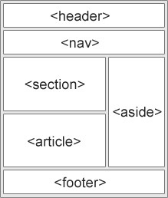
Semantic Elements
Page Structure elements
Easier to design interesting & fun web sites
<header> </header> element specifies a header for a document or section
<footer> </footer> element specifies a footer for a document or section.
Typically contains the author of the document, © information, links to terms of use, contact information, etc.
<section> </section>
<article> </article> independent, self contained content
<summary> </summary>

Slide 60
Cascading Style Sheets
Describes how HTML elements in a page are displayed.
Saves a lot of time and effort
Can describe and control how multiple Web pages are laid out, without having to redo the code for every page.
There are three main ways of adding CSS to HTML elements:
inline,
internal, and
external.

Slide 61
Inline CSS
Useful for applying a unique style to a single HTML element:
Inline styling uses the style attribute.
This inline styling changes the text color of a single heading:
<!DOCTYPE html>
<html>
<body>
<h1 style="color:blue">This is a Blue Heading</h1>
</body>
</html>
This is a Blue Heading

Slide 62
Internal Style
Can be used to define a common style for all HTML elements on a page
Internal styling is defined in the <head> section of an HTML page, using a <style> element:
<!DOCTYPE html>
<html>
<head>
<style>
body {background-color:lightgrey}
h1 {color:blue}
p {color:green}
</style>
</head>
<body>
<h1>This is a heading</h1>
<p>This is a paragraph.</p>
</body>
</html>

Slide 63
External Style
External style sheet are ideal when the style is applied to many pages.
You can change the look of an entire site by changing one file.
External styles are defined in the <head> section of an HTML page, in the <link> element:
<!DOCTYPE html
<html>
<head>
<link rel="stylesheet" href="styles.css” type=“txt/css”>
</head>
<body>
<h1>This is a heading</h1>
<p>This is a paragraph.</p>
</body>
</html>

Slide 64
Tables
Displaying data in a grid-like fashion
NOT for the purposes of laying out a web page, or the sections within a web page.
Tables are defined with the <table> tag.
Tables are divided into table rows with the <tr> tag.
Table rows are divided into table data with the <td> tag.
A table row can also be divided into table headings with the <th> tag.

Slide 65
HTML Tables
<table>
<tr>
<td>Jill</td> <td>Smith</td> <td>50</td>
</tr>
<tr>
<td>Eve</td> <td>Jackson</td> <td>94</td>
</tr>
<tr>
<td>John</td> <td>Doe</td> <td>80</td>
</tr>
</table>

Slide 66
Multi-media & Interactivity
Animation, Audio & Video

Slide 67
Objectives
3.3.8: Create and/or edit animation files, and integrate them into a Web page.
3.3.9: Create and/or edit video files, and integrate them into a Web page.
3.3.10: Use Dynamic HTML (DHTML) to enhance Web page interactivity.

Slide 68
Animation
Use animation to draw attention to information on a page.
Animation at its simplest refers to moving pictures such as:
a cartoon,
demonstrations to teach a concept
or scrolling text.
Rule: If the animation does not add specific value to your page, you are best off leaving it out.
Examples of animation that make sense are:
Public Service Announcements
Demonstrating a concept (teaching examples)
To draw attention to something new and exciting such as a new product or service

Slide 69
Audio
Audio file must be hosted on web server
Element: audio <audio> </audio>
Attributes: controls
Element: source
Attributes: src, type
<audio controls>
<source src="horse.ogg" type="audio/ogg">
<source src="horse.mp3" type="audio/mpeg">
Your browser does not support the audio element.
</audio>

Slide 70
Video
Videos can make your pages more interesting and are often used to share something that cannot be as easily described in text.
Common video types are:
.ogg (open source),
.mp4 and
.mov (Quicktime movies often associated with Apple).

Slide 71
Video
<video width="320" height="240" controls poster autoplay> <source src="movie.mp4" type="video/mp4"> <source src="movie.ogg" type="video/ogg"> <source src="movie.webm" type="video/webm"> Your browser does not support the video tag. </video>
<video> element = width, height, controls, poster, autoplay attributes
<source> element = src & type attributes

Slide 72
Video Attributes
Attribute | Value | Description
autoplay | autoplay | Specifies that the video will start playing as soon as it is ready
controls | controls | Specifies that video controls should be displayed (such as a play/pause button etc).
height | pixels | Sets the height of the video player
loop | loop | Specifies that the video will start over again, every time it is finished
muted | muted | Specifies that the audio output of the video should be muted
poster | URL | Specifies an image to be shown while the video is downloading, or until the user hits the play button
preload | auto metadata none | Specifies if and how the author thinks the video should be loaded when the page loads
src | URL | Specifies the URL of the video file
width | pixels | Sets the width of the video player

Slide 73
DHTML
Dynamic HyerText Markup Language (DHTML):
Combination of Web development technologies
Used to create:
animations
dynamically changing websites
DHTML enhances the website user’s experience. The technology may also be frustrating for users when it is used incorrectly.
Only use when relevant to web content
Technologies:
HTML
CSS
JavaScript or VBScript
Document Object Model (DOM)

